Slide 1
안드로이드 실무 13주차 과제
1901055 정시철

Slide 2
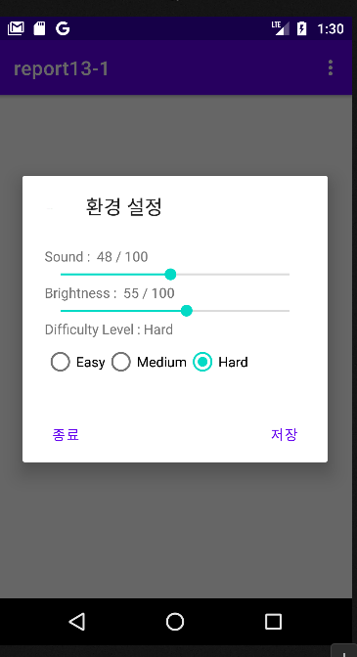
Report 1 환경설정 프로그램
package com.example.report13_1; import androidx.appcompat.app.AlertDialog; import androidx.appcompat.app.AppCompatActivity; import android.content.DialogInterface; import android.content.SharedPreferences; import android.os.Bundle; import android.view.Menu; import android.view.MenuItem; import android.view.View; import android.widget.RadioButton; import android.widget.RadioGroup; import android.widget.SeekBar; import android.widget.TextView; import android.widget.Toast; public class MainActivity extends AppCompatActivity { @Override protected void onCreate(Bundle savedInstanceState) { super.onCreate(savedInstanceState); setContentView(R.layout.activity_main); } @Override public boolean onCreateOptionsMenu(Menu menu) { menu.add(0, 1, 0, "환경 설정"); return true; } @Override public boolean onOptionsItemSelected(MenuItem item) { if (item.getItemId() == 1) { View innerView = getLayoutInflater().inflate(R.layout.dialog, null); final TextView text1 = innerView.findViewById(R.id.text1); final TextView text2 = innerView.findViewById(R.id.text2); final TextView text3 = innerView.findViewById(R.id.text3); final SeekBar sound = innerView.findViewById(R.id.sb1); sound.setOnSeekBarChangeListener(new SeekBar.OnSeekBarChangeListener() { @Override public void onProgressChanged(SeekBar seekBar, int progress, boolean fromUser) { text1.setText(String.format("Sound : %3d / %3d", progress, seekBar.getMax())); } @Override public void onStartTrackingTouch(SeekBar seekBar) { } @Override public void onStopTrackingTouch(SeekBar seekBar) { }}); final SeekBar brightness = innerView.findViewById(R.id.sb2); brightness.setOnSeekBarChangeListener(new SeekBar.OnSeekBarChangeListener() { @Override public void onProgressChanged(SeekBar seekBar, int progress, boolean fromUser) { text2.setText(String.format("Brightness : %3d / %3d", progress, seekBar.getMax())); } @Override public void onStartTrackingTouch(SeekBar seekBar) { } @Override public void onStopTrackingTouch(SeekBar seekBar) { }}); RadioButton r1 = innerView.findViewById(R.id.r1); RadioButton r2 = innerView.findViewById(R.id.r2); RadioButton r3 = innerView.findViewById(R.id.r3); RadioGroup radio = innerView.findViewById(R.id.radio); radio.setOnCheckedChangeListener( new RadioGroup.OnCheckedChangeListener() { @Override public void onCheckedChanged(RadioGroup group, int checkedId) { switch (checkedId) { case R.id.r1 : text3.setText(String.format("Difficulty Level : %s", r1.getText()));break; case R.id.r2 : text3.setText(String.format("Difficulty Level : %s", r2.getText()));break; case R.id.r3 : text3.setText(String.format("Difficulty Level : %s", r3.getText())); } }}); final SharedPreferences sharedPreferences= getSharedPreferences("gameSetting",MODE_PRIVATE); if(sharedPreferences!= null) { int bright = sharedPreferences.getInt("brightness", 30); int volume = sharedPreferences.getInt("sound",50); int checkedRadioButtonId = sharedPreferences.getInt("checkedRadioButtonId", R.id.r1); sound.setProgress(volume); brightness.setProgress(bright); radio.check(checkedRadioButtonId); } else { radio.check(R.id.r1); Toast.makeText(this,"기본값으로 설정되어 있습니다", Toast.LENGTH_LONG).show(); } AlertDialog.Builder builder = new AlertDialog.Builder(MainActivity.this); builder.setIcon(R.drawable.icon); builder.setTitle("환경 설정"); builder.setView(innerView); builder.setPositiveButton("저장", new DialogInterface.OnClickListener() { @Override public void onClick(DialogInterface dialog, int which) { SharedPreferences sharedPreferences= getSharedPreferences("gameSetting", MODE_PRIVATE); SharedPreferences.Editor editor = sharedPreferences.edit(); editor.putInt("brightness", brightness.getProgress()); editor.putInt("sound", sound.getProgress()); int checkedRadioButtonId = radio.getCheckedRadioButtonId(); editor.putInt("checkedRadioButtonId", checkedRadioButtonId); editor.apply(); Toast.makeText(MainActivity.this,"환경 설정을 저장합니다", Toast.LENGTH_LONG).show(); }}); builder.setNeutralButton("종료", null); builder.setCancelable(true); builder.create(); builder.show();return true; } return false; }}
<?xml version="1.0" encoding="utf-8"?> <LinearLayout xmlns:android="http://schemas.android.com/apk/res/android" android:orientation="vertical" android:padding="10pt" android:layout_width="match_parent" android:id="@+id/dialog" android:layout_height="match_parent"> <TextView android:id="@+id/text1" android:layout_width="match_parent" android:layout_height="wrap_content" android:text="Sound : 50 / 100"/> <SeekBar android:progress="50" android:id="@+id/sb1" android:layout_width="match_parent" android:layout_height="wrap_content" android:max="100"/> <TextView android:id="@+id/text2" android:layout_width="match_parent" android:layout_height="wrap_content" android:text="Brightness : 30 / 100"/> <SeekBar android:progress="30" android:id="@+id/sb2" android:layout_width="match_parent" android:layout_height="wrap_content" android:max="100"/> <TextView android:id="@+id/text3" android:layout_width="match_parent" android:layout_height="wrap_content" android:text="Difficult Level : Easy"/> <RadioGroup android:id="@+id/radio" android:layout_width="match_parent" android:layout_height="wrap_content" android:orientation="horizontal"> <RadioButton android:checked="true" android:layout_width="wrap_content" android:layout_height="wrap_content" android:text="Easy" android:id="@+id/r1"/> <RadioButton android:layout_width="wrap_content" android:layout_height="wrap_content" android:text="Medium" android:id="@+id/r2"/> <RadioButton android:layout_width="wrap_content" android:layout_height="wrap_content" android:text="Hard" android:id="@+id/r3"/> </RadioGroup> </LinearLayout>
<?xml version="1.0" encoding="utf-8"?> <LinearLayout xmlns:android="http://schemas.android.com/apk/res/android" xmlns:tools="http://schemas.android.com/tools" android:layout_width="match_parent" android:layout_height="match_parent" tools:context=".MainActivity"> <TextView android:layout_width="match_parent" android:layout_height="wrap_content" android:textAppearance="?android:attr/textAppearanceLarge" android:layout_gravity="center" android:gravity="center" android:textSize="20dp" android:text="Game Setting"/> </LinearLayout>

Slide 3
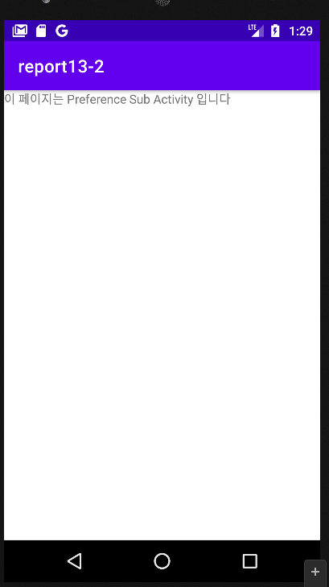
Report 2 preference 기본
정답 알려주신대로 코딩을 해봤는데 오류가 있길래 찾아봤더니 manifest가 설정이 안 되어 있어서 다시 수정한 후 manifest파일도 올려봅니다.
preference 선언은 5~6개가 돼있던데 막상 쓰는건 4개밖에 없길래 4개만 사용했습니다.
<?xml version="1.0" encoding="utf-8"?> <manifest xmlns:android="http://schemas.android.com/apk/res/android" package="com.example.report13_2"> <application android:allowBackup="true" android:icon="@mipmap/ic_launcher" android:label="@string/app_name" android:roundIcon="@mipmap/ic_launcher_round" android:supportsRtl="true" android:theme="@style/Theme.Report132"> <activity android:name=".Sixth" android:exported="false" /> <activity android:exported="false" android:name=".Fifth"> </activity> <activity android:name=".First" android:exported="false" /> <activity android:name=".Second" android:exported="false" /> <activity android:name=".Third" android:exported="false" /> <activity android:name=".Forth" android:exported="false" /> <activity android:name=".MainActivity" android:exported="true"> <intent-filter> <action android:name="android.intent.action.MAIN" /> <category android:name="android.intent.category.LAUNCHER" /> </intent-filter> <intent-filter> <action android:name=".Preferences" /> <category android:name="android.intent.category.PREFERENCE" /> </intent-filter> </activity> </application> </manifest>
<?xml version="1.0" encoding="utf-8"?> <PreferenceScreen xmlns:android="http://schemas.android.com/apk/res/android"> <CheckBoxPreference android:key="message" android:title="소리 알림" android:summary="소리로 알림을 받으려면 체크하세요"/> <SwitchPreference android:key="vibrate" android:title="진동 알림" android:summary="메시지가 왔을 때 진동 울림으로 알림을받으려면 체크하세요"/> <EditTextPreference android:key="nickname" android:title="Nickname" android:summary="Nickname을 설정하세요" android:dialogTitle="Nickname 설정"/> </PreferenceScreen>
프레퍼런스 5개, 레이아웃6
<?xml version="1.0" encoding="utf-8"?> <PreferenceScreen xmlns:android="http://schemas.android.com/apk/res/android"> <SwitchPreference android:defaultValue="false" android:key="update" android:title="자동 시스템 업데이트" /> <Preference android:key="mobile" android:title="이동통신망"> <intent android:targetClass="com.example.report02.Fifth" android:targetPackage="com.example.report02"/> </Preference> <Preference android:key="network" android:title="네트워크 운영자" android:summary="네트워크 운영자 선택"> <intent android:targetClass="com.example.report02.Sixth" android:targetPackage="com.example.report02"/> </Preference> </PreferenceScreen>
package com.example.report13_2; import androidx.appcompat.app.AppCompatActivity; import android.content.Intent; import android.os.Bundle; import android.view.Menu; import android.view.MenuItem; public class MainActivity extends AppCompatActivity { @Override protected void onCreate(Bundle savedInstanceState) { super.onCreate(savedInstanceState); setContentView(R.layout.activity_main); } @Override public boolean onCreateOptionsMenu(Menu menu) { menu.add(0, 1, 0, "환경 설정1"); menu.add(0, 2, 0, "환경 설정2"); menu.add(0, 3, 0, "환경 설정3"); menu.add(0, 4, 0, "환경 설정4");return true; } @Override public boolean onOptionsItemSelected(MenuItem item) { Intent intent; switch (item.getItemId()) { case 1: intent = new Intent(MainActivity.this, First.class); startActivity(intent);return true; case 2 : intent = new Intent(MainActivity.this, Second.class); startActivity(intent);return true; case 3 : intent = new Intent(MainActivity.this, Third.class); startActivity(intent);return true; case 4 : intent = new Intent(MainActivity.this, Forth.class); startActivity(intent);return true; } return false; }}
public class Sixth extends AppCompatActivity { @Override protected void onCreate(Bundle savedInstanceState) { super.onCreate(savedInstanceState); setContentView(R.layout.activity_sixth); }}
<?xml version="1.0" encoding="utf-8"?> <PreferenceScreen xmlns:android="http://schemas.android.com/apk/res/android"> <ListPreference android:key="sound" android:title="알림음" android:summary="카톡" android:entries="@array/array_voice" android:entryValues="@array/array_voice"/> <MultiSelectListPreference android:key="hobby" android:title="취미" android:summary="취미를 선택하세요" android:entries="@array/array_hobby" android:entryValues="@array/array_hobby"/> <RingtonePreference android:title="Choose Alarm" android:key="ringtone" android:summary="rington을 선택하세요"/> </PreferenceScreen>
<?xml version="1.0" encoding="utf-8"?> <PreferenceScreen xmlns:android="http://schemas.android.com/apk/res/android" android:title =" 이동통신망"> <SwitchPreference android:defaultValue ="false" android:key="roaming" android:summary ="로밍 시 데이터 서비스에 연결 " android:title ="데이터 로밍" /> <SwitchPreference android:key="lte_mode" android:summary ="LTE 서비스를 사용하여 음성및 기타 통신을 개선할 수 있습니다.(권장)" android:title ="향상된 4G LTE 모드" /> </PreferenceScreen>
public class Fifth extends PreferenceActivity { @Override protected void onCreate(Bundle savedInstanceState) { super.onCreate(savedInstanceState); addPreferencesFromResource(R.xml.preference5); }}
public class Forth extends PreferenceActivity { @Override protected void onCreate(Bundle savedInstanceState) { super.onCreate(savedInstanceState); addPreferencesFromResource(R.xml.preference4); }}
<?xml version="1.0" encoding="utf-8"?> <PreferenceScreen xmlns:android="http://schemas.android.com/apk/res/android"> <SwitchPreference android:defaultValue="false" android:key="update" android:title="자동 시스템 업데이트" /> <PreferenceCategory android:title="디버깅"> <SwitchPreference android:defaultValue="false" android:key="debugging" android:summary="USB가 연결된 경우 디버그 모드 사용" android:title="USB 디버깅" /> <CheckBoxPreference android:defaultValue="false" android:dependency="debugging" android:key="usb_app" android:summary="ADB/ADT를 통해 설치된 앱의 유해한동작이 있는지 확인" android:title="USB를 통해 설치된 앱 확인" /> </PreferenceCategory> </PreferenceScreen>
public class Third extends PreferenceActivity { @Override protected void onCreate(Bundle savedInstanceState) { super.onCreate(savedInstanceState); addPreferencesFromResource(R.xml.preference3); }}
<?xml version="1.0" encoding="utf-8"?> <LinearLayout xmlns:android="http://schemas.android.com/apk/res/android" xmlns:tools="http://schemas.android.com/tools" android:layout_width="match_parent" android:layout_height="match_parent" tools:context=".Sixth"> <TextView android:layout_width="wrap_content" android:layout_height="wrap_content" android:text="이 페이지는 Preference Sub Activity 입니다"/> </LinearLayout>
public class Second extends PreferenceActivity { @Override protected void onCreate(Bundle savedInstanceState) { super.onCreate(savedInstanceState); addPreferencesFromResource(R.xml.preference2); }}
public class First extends PreferenceActivity { @Override protected void onCreate(Bundle savedInstanceState) { super.onCreate(savedInstanceState); addPreferencesFromResource(R.xml.preference1); }}
매니페스트
메인 액티비티
클래스들

Slide 4
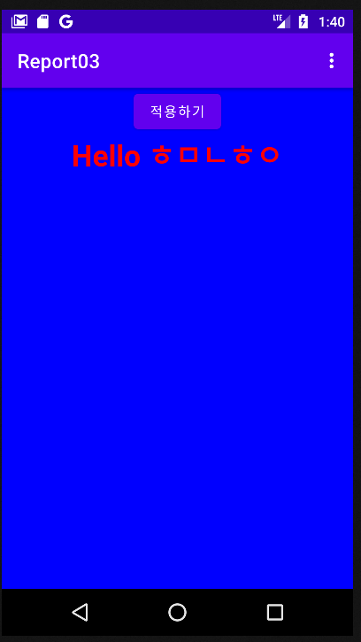
Report 3 환경설정 프로그램2
스트링
<resources> <string name="app_name">Report03</string> <string name="show_bold_text">showBoldText</string> <string name="user_name">userName</string> <string name="show_text_color">textColor</string> <string name="show_screen_color">screenColor</string> </resources>
어레이
package com.example.report13_3; import androidx.appcompat.app.AppCompatActivity; import android.content.Intent; import android.content.SharedPreferences; import android.graphics.Color; import android.graphics.Typeface; import android.os.Bundle; import android.preference.PreferenceManager; import android.view.Menu; import android.view.MenuItem; import android.view.View; import android.widget.Button; import android.widget.LinearLayout; import android.widget.TextView; public class MainActivity extends AppCompatActivity { SharedPreferences sharedPreferences; TextView textView; LinearLayout layout; @Override protected void onCreate(Bundle savedInstanceState) { super.onCreate(savedInstanceState); setContentView(R.layout.activity_main); layout = findViewById(R.id.layout); textView = findViewById(R.id.tv); sharedPreferences = PreferenceManager. getDefaultSharedPreferences(getApplicationContext());status(); Button button = findViewById(R.id.btn); button.setOnClickListener(new View.OnClickListener() { @Override public void onClick(View view) { status(); }}); } void status( ) { String showScreenColor = sharedPreferences.getString( getString(R.string.show_screen_color), "#FFFFFF"); String userName = sharedPreferences.getString( getString(R.string.user_name), "Guest"); boolean showBoldText = sharedPreferences.getBoolean( getString(R.string.show_bold_text), false); String showTextColor = sharedPreferences.getString( getString(R.string.show_text_color),"#000000"); if (showBoldText) { textView.setTypeface(null, Typeface.BOLD); } else { textView.setTypeface(null, Typeface.NORMAL); } layout.setBackgroundColor(Color.parseColor(showScreenColor)); textView.setTextColor(Color.parseColor(showTextColor)); textView.setText("Hello " + userName); } @Override public boolean onCreateOptionsMenu(Menu menu) { menu.add(0, 1, 0, "Settings");return true; } @Override public boolean onOptionsItemSelected(MenuItem item) { switch (item.getItemId()) { case 1: Intent intent = new Intent(getApplicationContext(), SettingActivity.class); startActivity(intent);return true; }return false; }}
<?xml version="1.0" encoding="utf-8"?> <resources> <string-array name="text_color_names"> <item>Red(빨간색)</item> <item>Blue(파랑색)</item> <item>Green(녹색)</item> <item>Black(검정색)</item> </string-array> <string-array name="text_color_values"> <item>#FF0000</item> <item>#00FF00</item> <item>#0000FF</item> <item>#000000</item> </string-array> <string-array name="screen_color_names"> <item>Red(빨간색)</item> <item>Blue(파랑색)</item> <item>Green(녹색)</item> <item>White(흰색)</item> </string-array> <string-array name="screen_color_values"> <item>#FF0000</item> <item>#00FF00</item> <item>#0000FF</item> <item>#FFFFFF</item> </string-array> </resources>
<?xml version="1.0" encoding="utf-8"?> <PreferenceScreen xmlns:android="http://schemas.android.com/apk/res/android"> <EditTextPreference android:key="@string/user_name" android:title="Input your name"/> <ListPreference android:key="@string/show_text_color" android:title="Select your text color?" android:entries="@array/text_color_names" android:entryValues="@array/text_color_values" android:defaultValue="#000000" android:negativeButtonText="@null"/> <CheckBoxPreference android:key="@string/show_bold_text" android:title="Display bold text?" android:defaultValue="false" android:summary="Select whether the app display bold text."/> <ListPreference android:key="@string/show_screen_color" android:title="Select your screen color?" android:entries="@array/screen_color_names" android:entryValues="@array/screen_color_values" android:defaultValue="#FFFFFF"/> </PreferenceScreen>
프레퍼런스
세팅 프래그먼트
package com.example.report13_3; import android.os.Bundle; import android.preference.PreferenceFragment; public class SettingsFragment extends PreferenceFragment { @Override public void onCreate(Bundle savedInstanceState) { super.onCreate(savedInstanceState); addPreferencesFromResource(R.xml.preference); }}
세팅 엑티비티
package com.example.report13_3; import android.os.Bundle; import android.preference.PreferenceActivity; public class SettingActivity extends PreferenceActivity { @Override protected void onCreate(Bundle savedInstanceState) { super.onCreate(savedInstanceState); getFragmentManager() .beginTransaction() .replace(android.R.id.content, new SettingsFragment()) .commit(); }}
매니페스트
<?xml version="1.0" encoding="utf-8"?> <manifest xmlns:android="http://schemas.android.com/apk/res/android" package="com.example.report13_3"> <application android:allowBackup="true" android:icon="@mipmap/ic_launcher" android:label="@string/app_name" android:roundIcon="@mipmap/ic_launcher_round" android:supportsRtl="true" android:theme="@style/Theme.Report133"> <activity android:name=".MainActivity" android:exported="true"> <intent-filter> <action android:name="android.intent.action.MAIN" /> <category android:name="android.intent.category.LAUNCHER" /> </intent-filter> </activity> <activity android:name=".SettingActivity" android:exported="true"/> </application> </manifest>
메인
<?xml version="1.0" encoding="utf-8"?> <LinearLayout xmlns:android="http://schemas.android.com/apk/res/android" xmlns:tools="http://schemas.android.com/tools" android:layout_width="match_parent" android:layout_height="match_parent" android:orientation="vertical" android:id="@+id/layout" tools:context=".MainActivity"> <Button android:id="@+id/btn" android:layout_width="wrap_content" android:layout_height="wrap_content" android:layout_gravity="center_horizontal" android:text="적용하기"/> <TextView android:id="@+id/tv" android:layout_width="wrap_content" android:layout_height="wrap_content" android:layout_gravity="center_horizontal" android:textSize="30dp"/> </LinearLayout>

